Slide 1
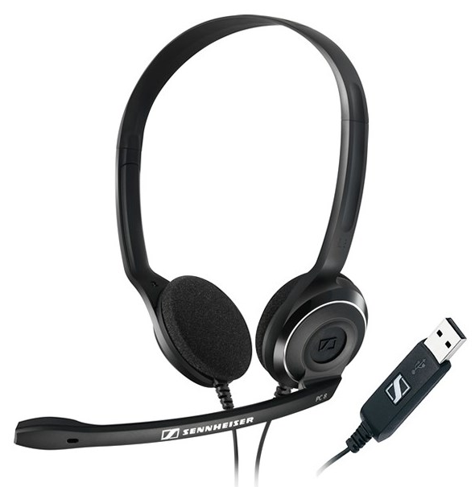
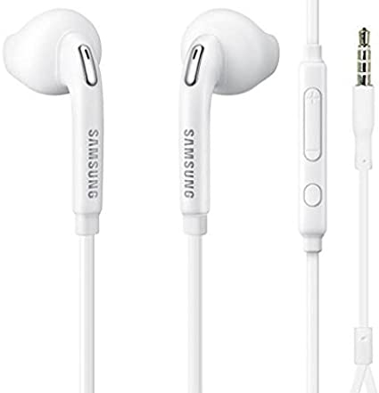
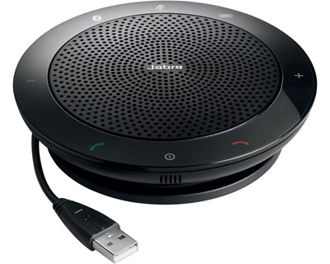
Good practice for efficient online meetings/supervision (I/II)
Ensure proper sound quality – lack of it causes frustrations:
  USB headsets: my preferred option
  Wired headsets that come with your smartphone are often surprisingly good
  Table speakerphones: typically work very well
  ÷ Bluetooth headsets:
      often time consuming to get them correctly set up, battery runs out etc.
      avoid solutions that can waist valuable meeting time
  ÷ Do not rely on the computer’s internal microphone
  Spend time properly adjusting your microphone prior the meeting
b) Ensure proper quality of screen sharing (for all participants)
  Needs sufficiently good internet connection
  Typically best to use ethernet cable from your router to you machine
    …especially if there are others at home using the WiFi
  Have efficient drawing tools at hand (Microsoft One Note, even Power Point, Xournal)

Slide 2
Good practice for efficient online meetings/supervision (II/II)
Meeting responsible:
  Test the chosen solution in advance (microphone, screen share, webcam)
  Know how to assist other participants if they experience problems
  Have access to backup conference solutions (Skype, Zoom, Vidyo, etc.)
Other participants:
  login couple of minutes before meeting start to make sure that your microphone/headset works correctly

Slide 3
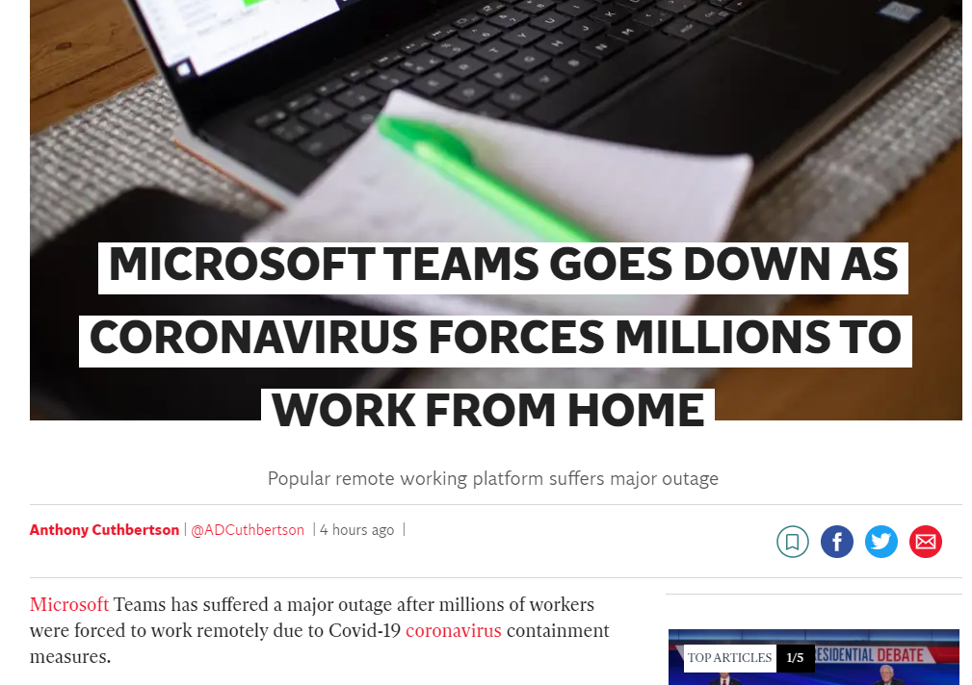
Good practice for efficient online teaching
Unusual times:
suddenly many University teachers going online
  Video conference solutions might become stressed
  Might be good option to record your lecture in advance as a backup solution (youtube or similar)
Source: www.independent.co.uk (16.3.2020)

Slide 4
Good practice for efficient online teaching
The use of online solutions might require us to slightly rethink our way of teaching
  Classroom lectures typically work well online
    Slides, whiteboard, video animations etc. are easy to manage
    The dialogue/interaction with students might be in different form
      The teachers questions to the class (to activate discussion) is difficult to manage
      Could be replaced by “pods” containing relevant question for students to answer
      (multiple choice, multiple options, short answers)
      Easy to allow students to ask questions during lecture (hand-raising button)
  Certain type of assignments also work well online
    Assignments carried out on computer are well suited for online supervision
    (e.g. simulation, programming or report writing)
  Assignments based on calculations by hand might be more difficult to support as well as laboratory based assignments

Slide 5
Video Conferencing Tools at DTU - Overview
DeiC – Danish E-infrastructure Cooperation
  Purpose: support Denmark as e-Science nation by delivering e-Infrastructure (computation, data storage and network) for research and research based education
  Danish Universities with access to effective conference solutions:
    Adobe Connect (good for large groups, teaching classes, etc., not for Linux)
    Zoom (Simple, good for supervision, works well on Linux)
Solutions through DTU - AIT:
  Vidyo (Simple, good for supervision and R&D collaboration, works well on Linux)
  Skype for business (Simple, robust, no support for Linux)
Other solutions:
  Skype
  Microsoft Teams (DTU access through www.office.com)

Slide 6
Adobe Connect
Well suited for larger groups/classes
  Good option for online live lectures:
    Various possibilities for interactions (hand-raising, polls, questionnaires)
  Good for assisting individual students on computer based assignments/reports
    Breakouts for individual consultations
    Screen share and screen control (useful for programming examples)
  Hand-raising tool:
    keep track of order in which students/groups that need help in the right order

Slide 7
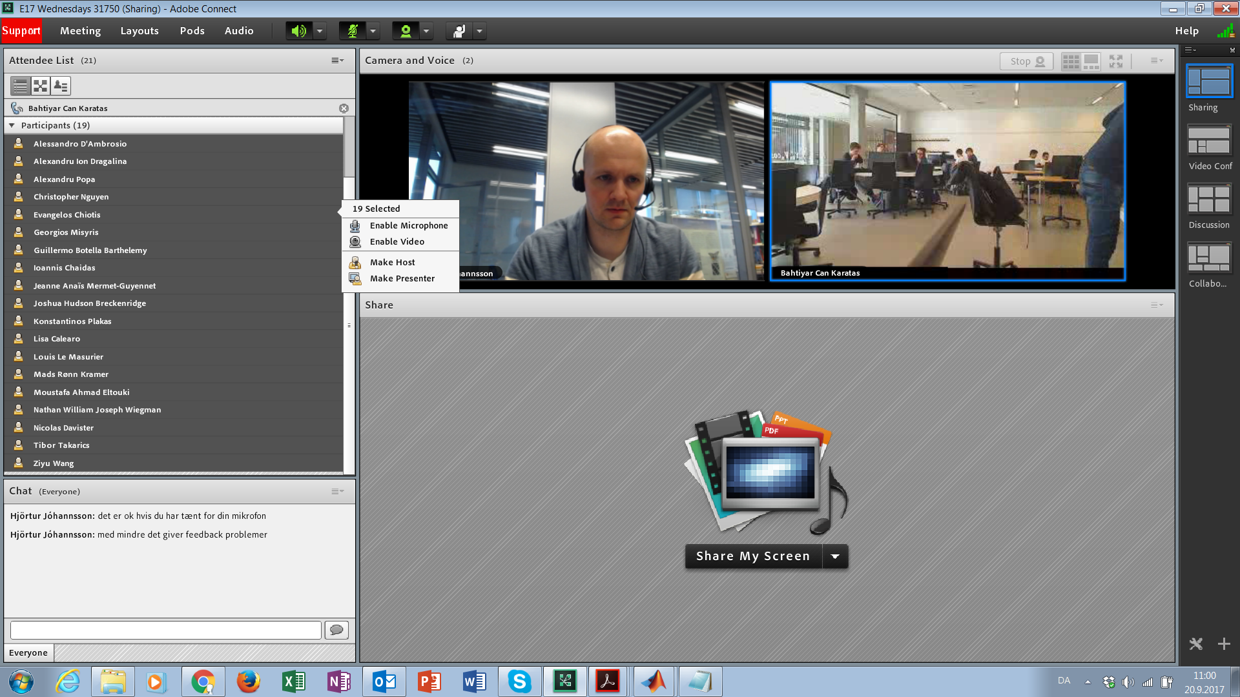
Adobe Connect
The hand-raising functionality is very usefull to keep track of students/groups that need help
For assisting the individual student, start a breakout session

Slide 8
Adobe Connect
What to be aware of?
  Proper connection in both ends for bi-lateral communication (otherwise delay)
  If you plug in your headset after you started Adobe Connect, the program does not always recognize it. Restart Adobe Connect to fix it.
  Before first meeting: login and test functionalities, share your screen to install the desktop application.
Create meetings at:
  https://c.deic.dk/
Further assistance :
  https://www.deic.dk/da/connect_igang (in Danish)
  https://www.deic.dk/en/node/570 (in English)

Slide 9
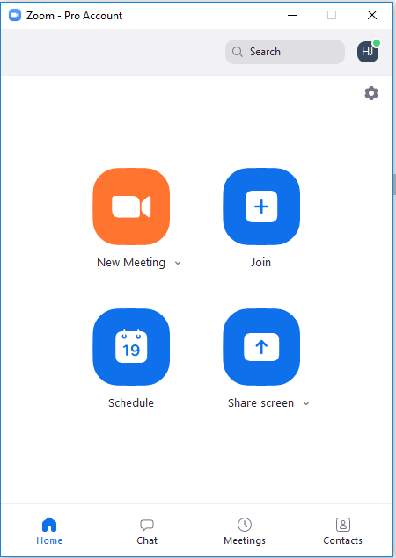
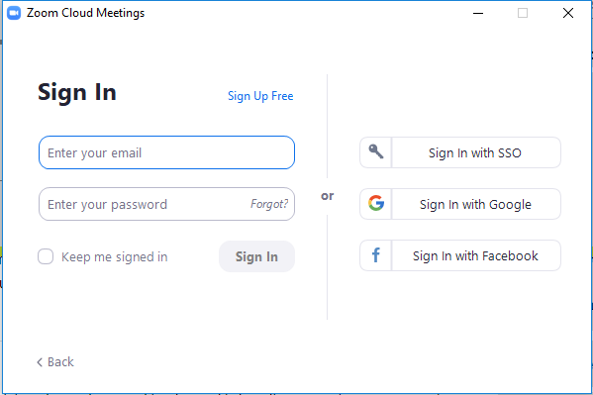
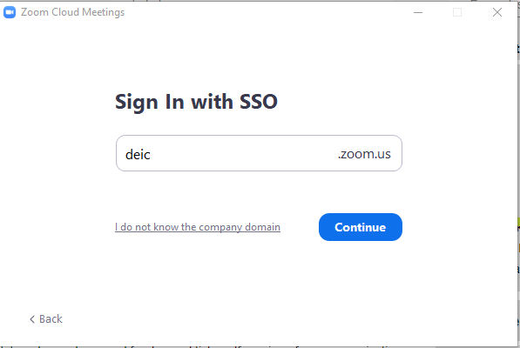
Zoom
Good for smaller meetings (supervision, project management, research group meetings)
Works well on most operating systems (Linux as well)
Simple interface, robust
Can join from H.323/SIP, Skype for Business or telephone

Slide 10
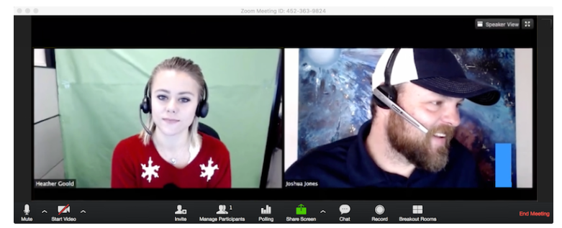
Zoom
Get started with Zoom:
  https://www.deic.dk/da/kom-i-gang-0 (Danish)
  https://www.deic.dk/en/get-started-zoom (English)
Further assistance:
  https://support.zoom.us/hc/en-us/articles/206618765-Zoom-Video-Tutorials

Slide 11
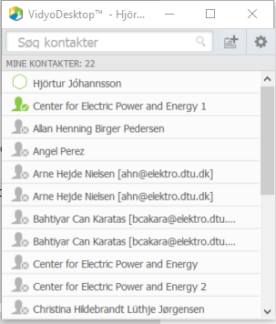
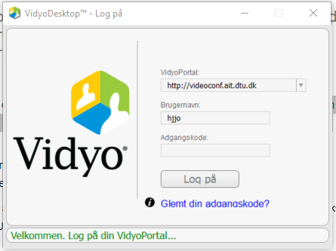
Vidyo
Similar to Zoom
Good for smaller meetings (supervision, project management, research group meetings)
Works well on most operating systems (Linux as well)
Simple interface, robust

Slide 12
Vidyo
Go to: http://videoconf.ait.dtu.dk/ to download the SW-client
Login with your DTU initials and password

